Slide 1
Faculty Senate Meeting
April 27, 2023

Slide 2
Meeting procedure
Only Senators may debate motions
Only Senators can vote
If you are not a Senator, or a proxy, you cannot vote or debate
Do not speak over someone, or out of order
  Raise your hand to speak
  The President may call on you and then you will have the floor
Unless you have been recognized (been told you have the floor), you may not speak

Slide 3
Meeting Minutes
We will be using Robert's Rules to guide our recording of minutes.
Robert's Rules of Order say that meeting minutes are simply a summary of what happened at the meeting.
They are not a play by play of everything that happened or what members said.
If needed, Faculty Senators may request access to the audio recording of the meeting. Please email facsenate@mst.edu with justification.

Slide 4
Agenda
Call to Order and Roll Call
D. Westenberg, Secretary

Slide 5
Agenda
Approval of Minutes
March 23, 2023

Slide 6
Agenda
III. President’s Report
K. Sheppard

Slide 7
Campus Matters:
Faculty Senate/Staff Council Climate Survey
Running through April 29
Important to take, despite COACHE and ADVANCE earlier
  Staff not included in COACHE or ADVANCE
  Our data moves faster than COACHE (once every three years)
  ADVANCE was a specific type of input
Building longitudinal data for multi-year trends
Administration, Trustees, others are watching the trends

Slide 8
Panopto Video Retention
Only keeping videos that get played every 18 months
If you want to keep videos for classes that only run every 2 years or more, push play once a year so they remain “live.”
They’ll be archived after 18 mos. Deleted after 3 years
It is significantly more expensive for the three-year option ($200K vs. $51K)

Slide 9
Campus Matters:
P&T Committee/Tenure Policy Committee
There was a discussion underway for some changes on the campus P&T committee.
Those are on indefinite hold for now.
Rather than change the processes for now, we first need to make sure that the processes are followed.
  Example: Everyone on the committees need to read and understand the dossiers.

Slide 10
Campus Matters: Board of Curators Meeting
April 20th, 2023 in Rolla
Approved our By-Laws revisions
Approved the test optional undergraduate admissions pilot one-year extension
Student/Curator Luncheon went well!

Slide 11
Feedback on CRR changes
200.010: Standard of Conduct
200.020: Rules of procedure in Student or Student Organization Conduct Matters
We’ll send out a Google poll, with information, for your and all faculty feedback.
We need feedback by May 3.
  It’s a quick turnaround, but we need time to sift through comments before IFC on May 8th.

Slide 12
Feedback on CRR Changes
Updating and improving the rules
200.010 examples: academic dishonesty, safety, law violation, retaliation
200.020 examples: statements on policies and rights and preliminary procedures, notices to students/orgs, rights of parties at conduct hearings

Slide 13
Library Dean Search
Candidates are coming next week and the week after.
Be on the lookout for events.
Do you care about access to your research and scholarship resources? Then you care about this!

Slide 14
Gen Fac meeting
May 2, 2023
4:00pm
Here, in BCH 125
Memorial Resolutions
Faculty Award recognitions
Year-end reports from Chancellor and Provost

Slide 15
Questions?

Slide 16
Agenda
IV. Campus Reports
  A. Staff Council
  M. Fowler
  (No report)

Slide 17
Agenda
IV. Campus Reports
  B. Student Council
  S. Young

Slide 18
Definitive Executive Team
  VP Engagement and Outreach: Jordan Ropp
  VP of Operations: Martin De La Hunt
  VP of Academic Affairs: Lucas Ethington
  VP of Student Services: Grace Giesler
  CEC Chair: Markus Baur
  CASE Chair: Madison Jolly

Slide 19
  Bylaw Revisions
  Student Interest Forms
    Closed on the 24th
    Will be reviewing data on the 2nd
  CET Evaluations
    Would like to follow up with CET committee

Slide 20
Agenda
IV. Campus Reports
  C. Council of Graduate Students
  M. Twarakavi

Slide 21
Agenda
V. Reports of Standing Committees
A. Campus Curricula
P. DeWitt

Slide 22
Campus Curricula Committee Report
April 27, 2023
CCC Meeting
- April 6, 2023
Total Committee Activity
  18 Course Change Requests (CC Forms)
  5 Program Change Forms (PC Forms)
  6 Experimental Course Requests (EC Forms)
  1 Department Name Change

Slide 23
Campus Curricula Committee Report
April 27, 2023
Course Changes (CC) Requested
File: 2021.1 ART 1164 : Sculpture
File: 4891 CHEM 5650 : Introduction to Medicinal Chemistry
File: 358.1 CIV ENG 6331 : Advanced Open-Channel Hydraulics
File: 4942 ECON 3300 : Introduction to Econometrics
File: 4937 ECON 3333 : Computational Economics
File: 4936 ECON 4383 : Financial Economics
File: 4940 ECON 4538 : Advanced Econometrics
File: 4941 ECON 5360 : Data Driven Strategic Insights
File: 1688.1 ELEC ENG 6320 : Nonlinear Control Systems
File: 4557.3 ELEC ENG 6370 : Adaptive Control
File: 32.7 ENGLISH 2560 : Technical Marketing Communication
File: 4962 ENV SCI 1001 : Special Topics
File: 4960 ENV SCI 2001 : Special Topics
File: 4963 ENV SCI 3001 : Special Topics
File: 4964 ENV SCI 4001 : Special Topics
File: 4965 ENV SCI 5001 : Special Topics
File: 320.9 ERP 6220 : Data Modeling & Visualization Prototyping for Enterprise Decision Dashbd
File: 4499.8 FINANCE 5310 : Financial Technology and Analytics

Slide 24
Campus Curricula Committee Report
April 27, 2023
Program Changes (PC) Requested
File: 151.18 CHEM-BA : Chemistry BA
File: 395 PROPOSED : Decision Data Analytics – CTU
File: 396 PROPOSED : Energy Economics – CTU
File: 394 PROPOSED : Financial Economics and Technology – CTU
File: 392 PROPOSED : Undergraduate Certificate in Medical Chemistry CTU

Slide 25
Campus Curricula Committee Report
April 27, 2023
Department Name Change Requested
8 : Education

Slide 26
Campus Curricula Committee Report
April 27, 2023
  For Informational Purposes; No Senate Approval Required
  Experimental Course (EC) Requested
File: 4944 BUS 5001.001 : Sport Management
File: 4945 BUS 5001.002 : The Business of eSports
File: 4938 CHEM ENG 5001.018 : Mathematic Applications for Chemical Engineering
File: 4907 ELEC ENG 5001.009 : Batch Process Control
File: 4946 IS&T 5001.003 : Fundamentals of Cybersecurity Analytics
File: 4939 PSYCH 4001.001 : Music and the Mind

Slide 27
Campus Curricula Committee Report
March 23, 2023
Curriculum committee moves for FS to approve the 18 CC and 5 PC form actions as well as 1 department name change.
Discussion: Questions or comments?

Slide 28
Agenda
V. Reports of Standing Committees
B. CET
D. Burns

Slide 29
Committee for
Effective Teaching
Presentation to Faculty Senate
April 27, 2023

Slide 30
Update on hiding offensive comments
Faculty will receive an email after results are in with instructions for flagging comments
It's an option for those who want it for qualifying comments
  This procedure is focused on offensive and discriminatory comments, especially those related to race, ethnicity, gender, or other protected classes
  It is not intended for comments that are merely critical, irrelevant, or those that you feel misrepresent the course
Faculty will have 3 weeks to review and flag comments before they are released to chairs and upper administration
IT will send anonymized comments to a review panel made of the CET chair, the faculty ombudsperson, and the Chief Diversity Officer/delegate
The committee has a week to approve/reject
Chair thus see comments 4 weeks after release

Slide 31
Peer Observation
For next academic year we are recruiting a group of ~10 observers with expertise in teaching and/or evaluation
CAFÉ will help us train them to consistently use a rubric for observations
Faculty volunteering to be observed will have a pair of observers who will have a pre-meeting, a classroom observation, an online course material observation, and a post-meeting to discuss results
Observers will receive a 1-semester course-release or other compensation (research/travel/development funds)

Slide 32
The Future
Eventually (Fall 2024?) the provost wants every faculty member observed once per year (regardless of load)
We think we can get this done with ~30 observers doing ~15 observations per semester
Official procedures will be detailed in the future!
CAFÉ teaching partners and other programs will be targeted at formative (instead of summative) evaluation
Intra-Departmental observations could focus on content coverage

Slide 33
Agenda
V. Reports of Standing Committees
C. Personnel
D. Westenberg

Slide 34
Agenda
V. Reports of Standing Committees
D. ITCC
P. Koob

Slide 35
Update From IT
  Windows 11 Armageddon
  Starting with computers impacted in November Windows Update Failure, we are contacting departments about desktop computers that are security risks and support issues because they are too old to take updates and presenting options.
  We are contacting departments about aged departmental computer learning centers and presenting options.
  Will no longer be able to install Window 10 on computers after June.
  Google Workspace for Education Plus
  Removal of legacy Gmail data in 11/2023.

Slide 36
Agenda
V. Reports of Standing Committees
E. Student Affairs
D. Westenberg (for F. Oboh-Ikuenobe)

Slide 37
Student Affairs Committee
Presentation to Faculty Senate
April 27, 2023

Slide 38
Resolution on Priority Registration
Students registered with disability support services, military-connected students, and student athletes are eligible for priority registration and may enroll on the first day that registration begins. Military-connected students include veterans, those currently serving in the military, Reserves, or National Guard, and other students that are using a VA or DoD program to fund their education. Student athletes are members of any NCAA intercollegiate sport team at Missouri S&T.

Slide 39
Agenda
V. Reports of Standing Committees
F. Budgetary Affairs
M. Fitch

Slide 40
Budgetary Affairs Committee
March 23, 2023
Referrals
None, but query on Protoplex internal funding
Continuing referrals:
Current and next FY budget
Report on the “big picture balance sheet”

Slide 41
Protoplex Funding
Funding sources
$20 MM in Federal earmarks,
$ 30 MM Kummer Foundation,
$46 MM state funds
Geothermal heating/cooling added
Inflation Reduction Act geothermal tax credit available
Geothermal plant added, $8.8 MM internal funds
Future tax credits at least $8.8 MM
Geothermal should reduce operational cost by $100-200k per year

Slide 42
Budget timeline
Now: keep track of
state budget bills, departments building budgets, and
enrollment projections [two A&R days remain, 9 Jun & 14 Aug], have reasonable guesstimate of budget changes
Mid-May: State budget signed, appropriation known, have fair guesstimate
Mid to late May: Enrollment (tuition) estimate set → budget values set
June: Salary guidelines released
Late June: Curators approve budget
July 1: start Fiscal Year
Sept 1: start salary year for academic employees

Slide 43
Budget
Current FY budget
Financial aid (discount) better than expected, not all $1 million contingency gone
Staff turnover getting better (worst last year 19.67%, now 13.67%)
Next year (FY 2024)
State appropriation: 7% increase likely (Gov, Senate, House) = +$3.9 MM
Tuition:
  Enrollment projection: +68 freshman, net -0 undergrads, +40 grad students
  Tuition model change to tiers, designed as net zero change
  But inflation may drive tuition increase (early May Curator’s meeting)
Buildings:
  $25 MM for ERL, Schrenk, and extend geothermal to Parker, Norwood, and Harris

Slide 44
General Revenue Budget
 | FY 21 | FY 22 | FY 23 (budgeted) | FY 24 (vague dream)
Tuition and Fees | $119,477,148 | $119,255,572 | $123,885,664 | $123,529,412
Scholarship Allowance | (36,728,607) | (38,692,747) | (41,287,426) | (39,529,412)
Discount | 31% | 32% | 33% | 32%
Net Tuition & Fees | $83,748,541 | 80,562,825 | 82,598,238 | 84,000,000
State Appropriation | 45,690,941 | 53,026,096 | 55,942,347 | 59,858,861
Gift Revenues | 493,109 | 441,381 | 347,500 | 350,000
Recovery of F & A | 6,496,349 | 7,611,796 | 7,290,000 | 8,000,000
Endowment & Investment Income | 1,891,705 | 3,399,798 | 3,391,902 | 3,391,902
Sales & Services Income | 709,380 | 1,125,303 | 999,930 | 1,000,000
Other Incomes | 2,209,518 | 2,841,403 | 2,067,024 | 2,000,000
Revenue Contingency |  | - | - | -
Total Revenues | $140,239,544 | $149,008,602 | $152,636,941 | $158,600,763
Enrollment: 0 UG, +40 grad
Discount rate declining
7% increase
Blank = covers $1 MM tuition shortfall
+6 million w/o tuition increase

Slide 45
General Revenue Budget: costs
Total Revenues | $140,239,544 | $149,008,602 | $152,636,941 | $158,636,941
+$6 million why not?
Transfers | FY 21 | FY 22 (actual*) | FY 23 (budgeted) | FY 24 (hallucinated)
Internal | $1,988,391 | ($1,097,298) | $1,470,667 | $1,470,667
Mandatory Transfers | (3,483,219) | (3,285,882) | (3,376,171) | (3,376,171)
NonMandatory Transfers | (7,114,077) | (4,445,964) | (3,850,000) | (3,850,000)
Total Transfers | ($8,630,105) | ($8,829,144) | ($5,755,504) | ($5,755,504)
Expenditures
Salaries & Wages | $75,195,068 | $72,970,747 | $80,441,613 | $85,268,110
Benefit Expense | 24,209,899 | 23,542,539 | 27,358,459 | 28,999,967
Compensation | $99,404,966 | $96,513,286 | $107,800,003 | $114,268,076
Other Expenses | 32,471,617 | 35,350,345 | 39,049,616 | 40,299,616
Total Expenditures | $131,876,584 | $131,863,631 | $146,849,689 | $154,567,692
 |  | Increase from previous year: | $14,986,058 | $7,720,000
[2022 Inflation 6.5%]
[2023 Inflation 5%?]
3% + 0.5% raise
But: Enrollment Mgt ↑,
Annual Giving reincarnation.
…and new hires?
Guessed increases:
Maintenance +500k
Utilities +500k
Insurance, etc. +250k

Slide 46
Agenda
VI. Elections
K. Homan

Slide 47
Faculty Senate Elections 2023

Slide 48

Is this slate of candidates acceptable?
Yes
No

Slide 49
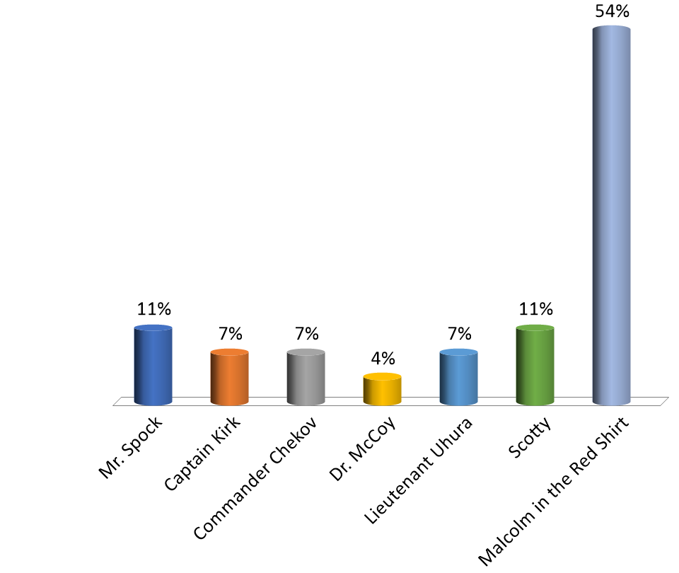
Floor Nominations
(add nominations from the floor then poll slide)
Mr. Spock
Captain Kirk
Commander Chekov
Dr. McCoy
Lieutenant Uhura
Scotty
Malcolm in the Red Shirt

Slide 50
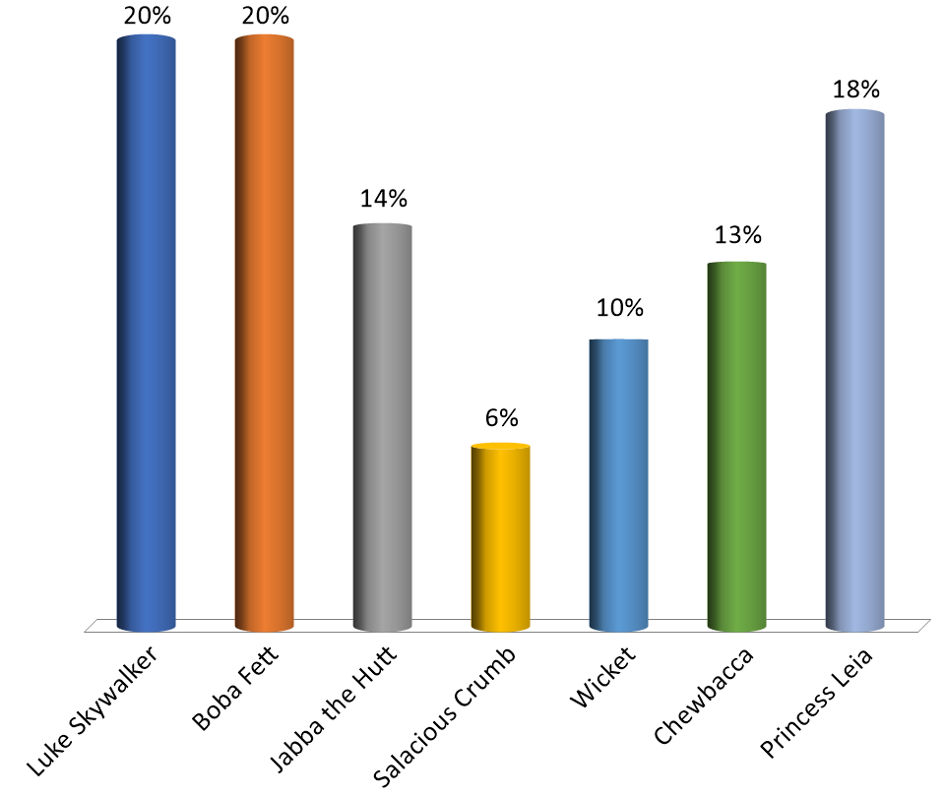
Select X of Y options
(Pick a specific number out of range of choices)
Which characters are humans?
Luke Skywalker
Boba Fett
Jabba the Hutt
Salacious Crumb
Wicket
Chewbacca
Princess Leia

Slide 51
Election Overview
Committee | RP&A Cmte | Faculty Senate | Academic Depts
Senate Officers | 5 | - | -
Admin Review (ARC) | 3 | - | -
Academic Freedom & Standards (AFS) | - | - | 3
Budgetary Affairs (BAC) | - | 2 | 2
Campus Curriculum (CCC) | - | 1 | -
Facilities Planning (FPC) | - | 3 | 4
Honorary Degrees (HD) | - | - | 4
Intellectual Property And Tech Transfer (IPTT) | - | 4 | -
Library and Learning Resources (LLRC) | - | - | 6
Personnel (PC) | - | 1 | 2
Student Affairs (SAC) | - | 1 | 4

Slide 52

2023-24 Faculty Senate Officer Slate
Nominated by Faculty Senate RP&A – 5 positions
Position | Nominee | Dept/College
President | KC Dolan | ETC/CASE
Past-President | Kate Sheppard | HPS/CASE
President-Elect | Dave Westenberg | BioSci/CASE
Parliamentarian | Michael Gosnell | CS/CEC
Secretary | Venkat Allada | EMSE/Kummer
Yes
No

Slide 53
Administrative Review Committee (ARC)
Nominated by RP&A – 3 open positions
Nominee | Dept/College
Bih-Ruh Lea | BIT/Kummer
Kelly Liu | GGPE/CEC
Kelvin Erickson | ECE/CEC
Yes
No

Slide 54
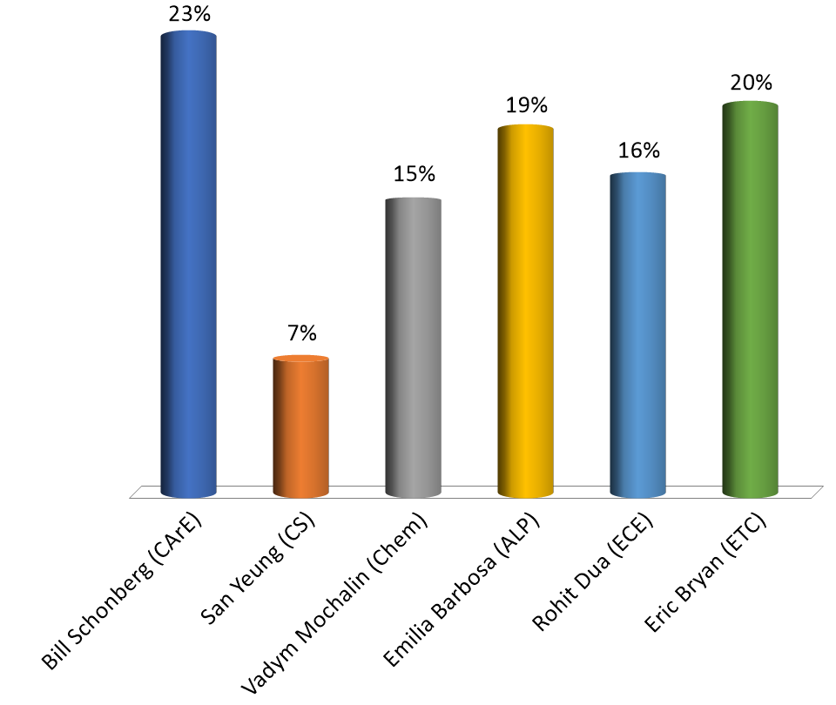
Academic Freedom & Standards (AF&S)
Nominees from Academic Depts – 3 open positions
Bill Schonberg (CArE)
San Yeung (CS)
Vadym Mochalin (Chem)
Emilia Barbosa (ALP)
Rohit Dua (ECE)
Eric Bryan (ETC)

Slide 55
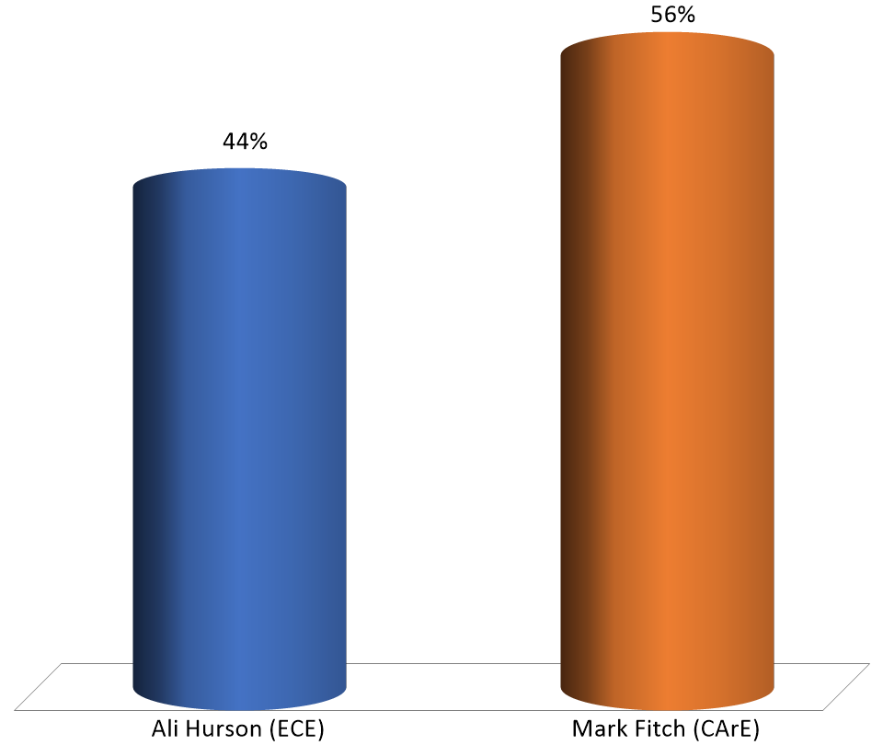
Budgetary Affairs Cmte (BAC)
Nominees from Faculty Senate - 2 open positions
Ali Hurson (ECE)
Mark Fitch (CArE)

Slide 56
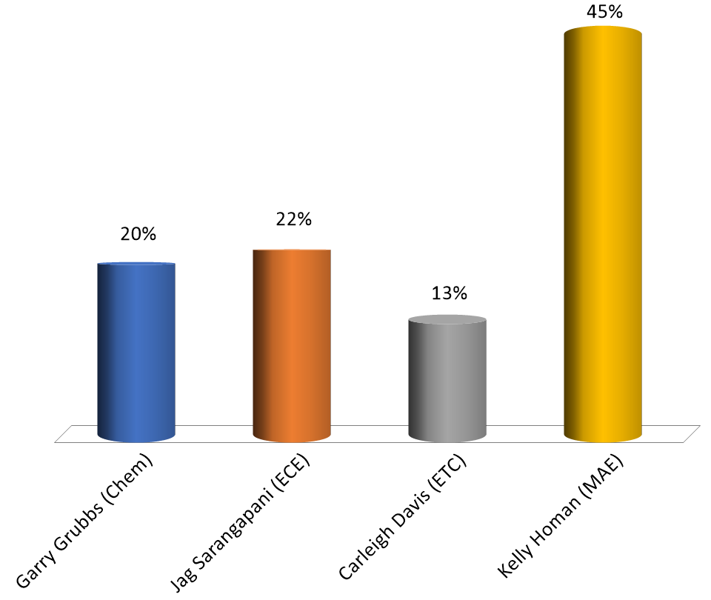
Budgetary Affairs Cmte (BAC)
Nominees from Academic Depts – 2 open positions
Garry Grubbs (Chem)
Jag Sarangapani (ECE)
Carleigh Davis (ETC)
Kelly Homan (MAE)

Slide 57
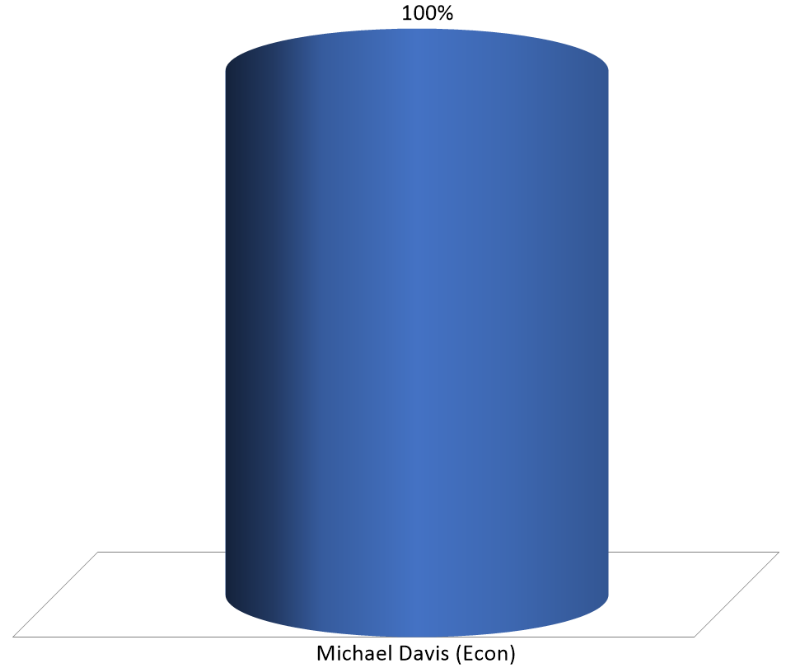
Campus Curriculum Cmte (CCC)
Nominees from Faculty Senate – 1 open position
Michael Davis (Econ)

Slide 58
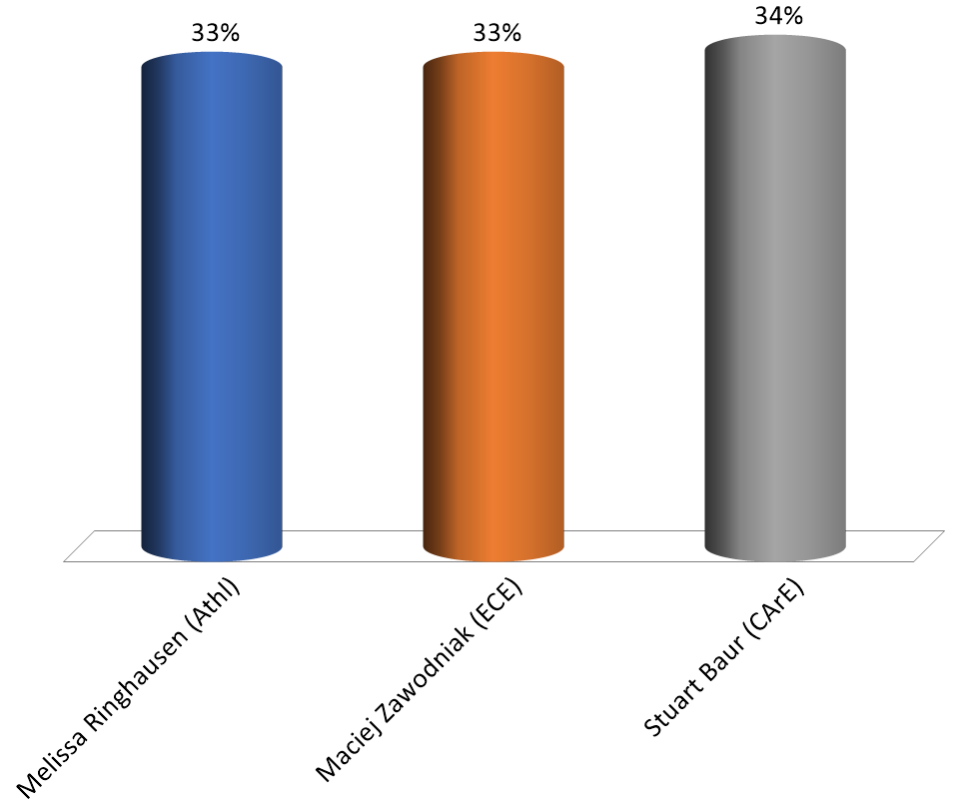
Facilities Planning Cmte (FPC)
Nominees from Faculty Senate – 3 open positions
Melissa Ringhausen (Athl)
Maciej Zawodniak (ECE)
Stuart Baur (CArE)

Slide 59
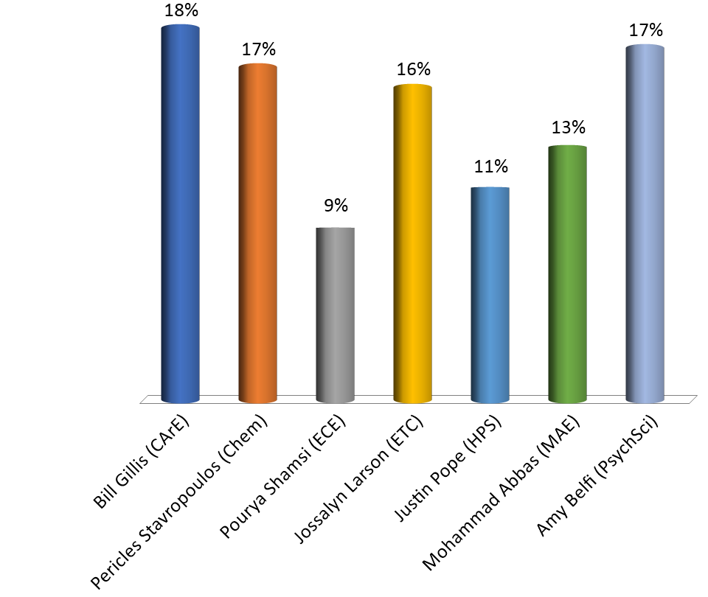
Facilities Planning Cmte (FPC)
Nominees from Academic Depts – 4 open positions
Bill Gillis (CArE)
Pericles Stavropoulos (Chem)
Pourya Shamsi (ECE)
Jossalyn Larson (ETC)
Justin Pope (HPS)
Mohammad Abbas (MAE)
Amy Belfi (PsychSci)

Slide 60
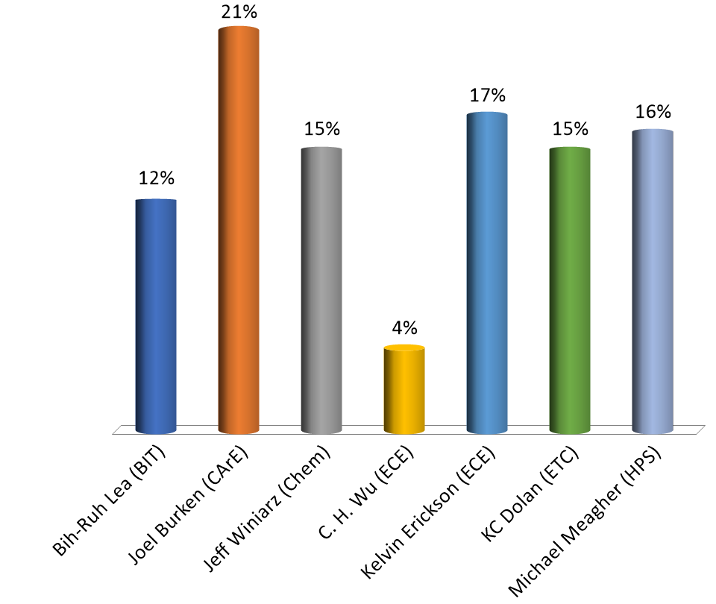
Honorary Degrees (HD)
Nominees from Academic Depts – 4 open positions
Bih-Ruh Lea (BIT)
Joel Burken (CArE)
Jeff Winiarz (Chem)
C. H. Wu (ECE)
Kelvin Erickson (ECE)
KC Dolan (ETC)
Michael Meagher (HPS)

Slide 61
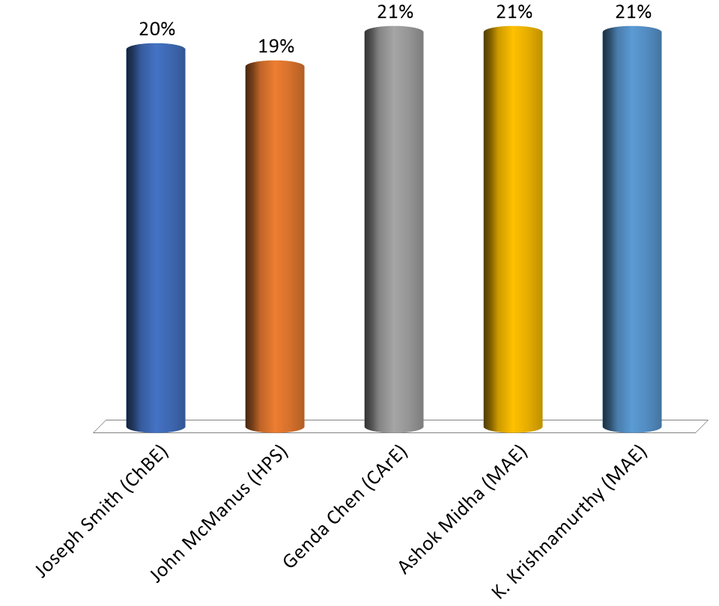
Intellectual Property and Tech Transfer (IPTT)
Nominees from Faculty Senate – 4 open positions
Joseph Smith (ChBE)
John McManus (HPS)
Genda Chen (CArE)
Ashok Midha (MAE)
K. Krishnamurthy (MAE)

Slide 62
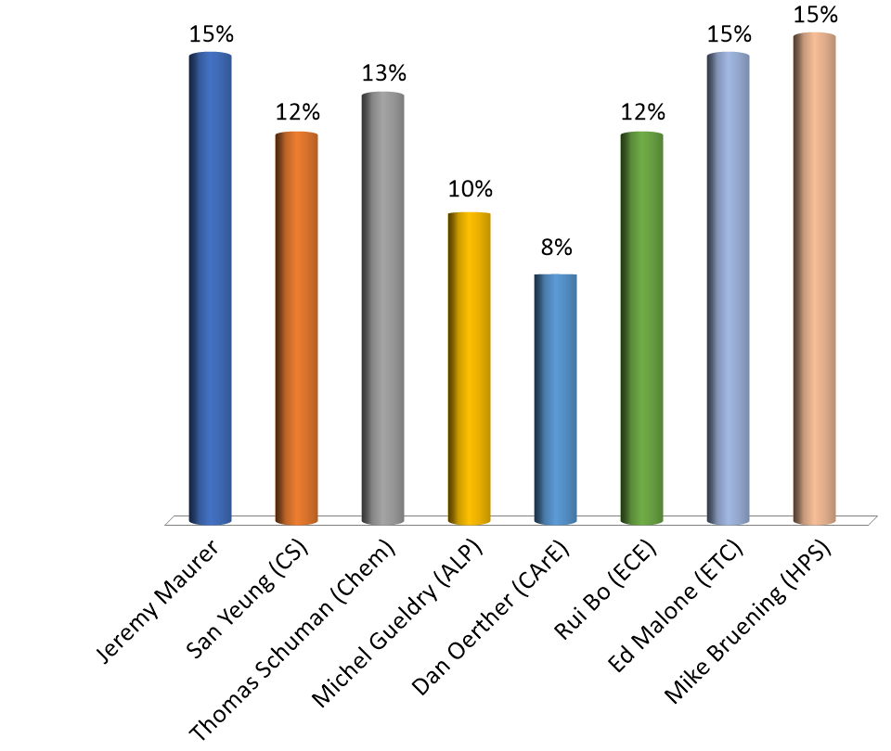
Library and Learning Resource (LLRC)
Nominees from Academic Depts – 6 open positions
Jeremy Maurer
San Yeung (CS)
Thomas Schuman (Chem)
Michel Gueldry (ALP)
Dan Oerther (CArE)
Rui Bo (ECE)
Ed Malone (ETC)
Mike Bruening (HPS)

Slide 63
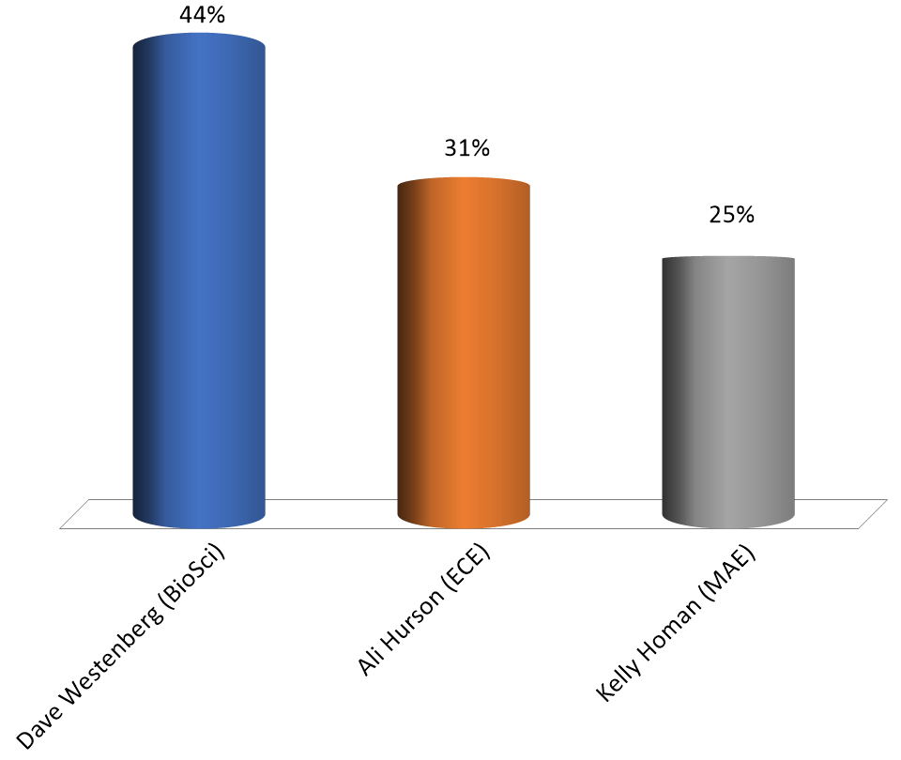
Personnel Cmte (PC)
Nominees from Faculty Senate – 1 open position
Dave Westenberg (BioSci)
Ali Hurson (ECE)
Kelly Homan (MAE)

Slide 64
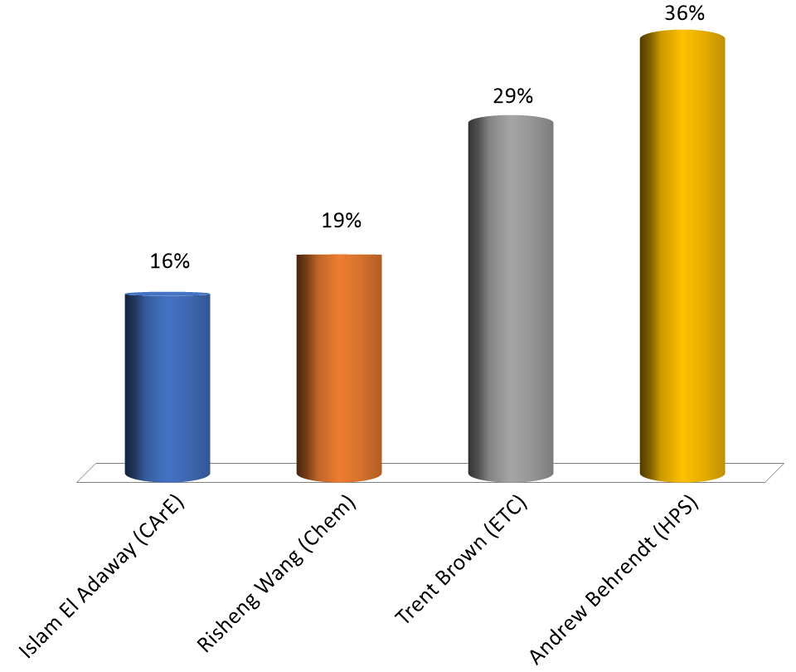
Personnel Cmte (PC)
Nominees from Academic Depts – 2 open positions
Islam El Adaway (CArE)
Risheng Wang (Chem)
Trent Brown (ETC)
Andrew Behrendt (HPS)

Slide 65
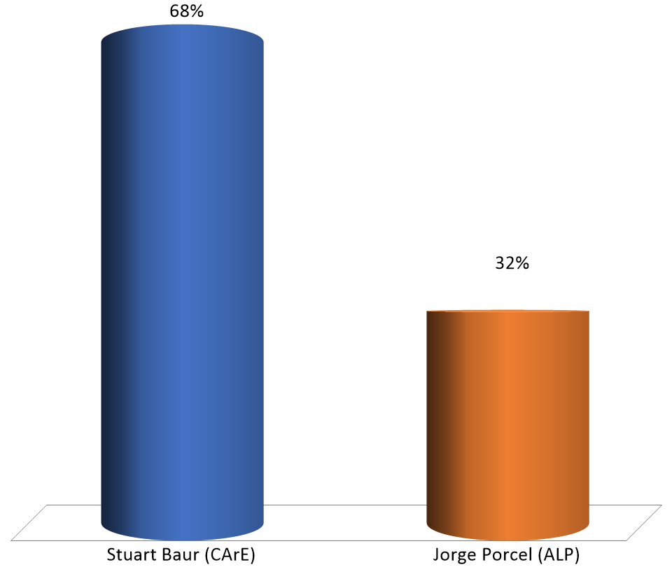
Student Affairs Cmte (SAC)
Nominees from Faculty Senate – 1 open position
Stuart Baur (CArE)
Jorge Porcel (ALP)

Slide 66
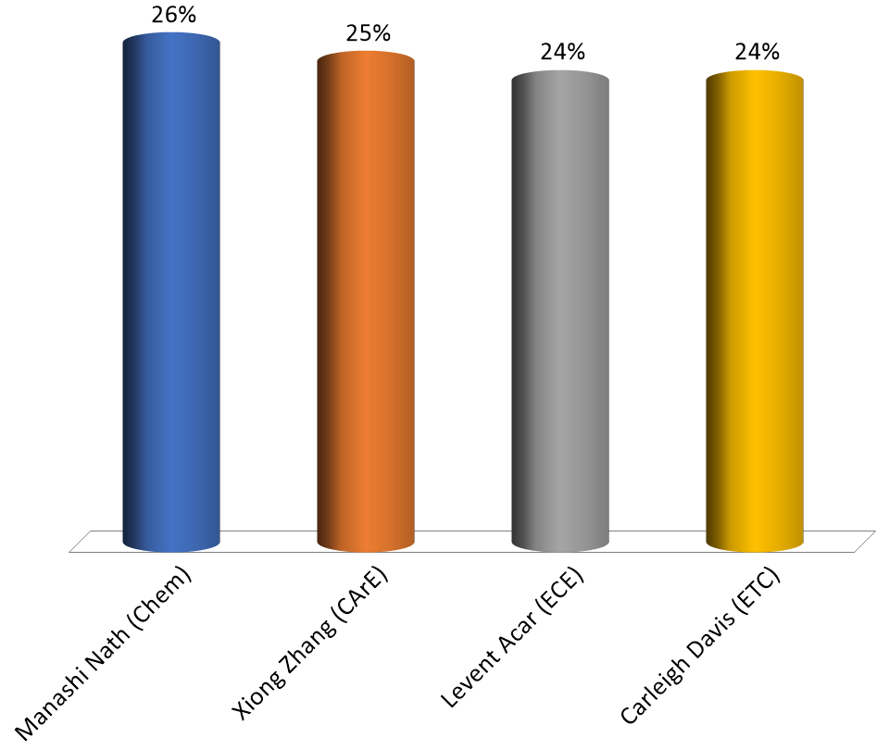
Student Affairs (SAC)
Nominees from Academic Depts – 4 open positions
Manashi Nath (Chem)
Xiong Zhang (CArE)
Levent Acar (ECE)
Carleigh Davis (ETC)

Slide 67
Agenda
VII. Adjourn
67

